Slide 1
8051 MICRCONTROLLER
Farhan Sadaf
Lecturer, Dept. of CSE

Slide 2
8051 MICRCONTROLLER
The 8051 microcontroller is a very popular 8-bit microcontroller introduced by Intel in the year 1981 and it has become almost the academic standard now a days.
The 8051 is based on an 8-bit CISC core with Harvard architecture.
Its 8-bit architecture is optimized for control applications with extensive Boolean processing.

Slide 3
SALIENT FEATURES
4 KB on chip program memory(ROM)
128 bytes on chip data memory(RAM)
8-bit data bus
16-bit address bus
32 general purpose registers each of 8 bits
Two -16 bit timers T0 and T1
Five Interrupts (3 internal and 2 external)
Four Parallel ports each of 8-bits (PORT0, PORT1, PORT2, PORT3) with a total of 32 I/O lines

Slide 4
SALIENT FEATURES
One 16-bit program counter and One 16-bit DPTR (data pointer)
One 8-bit stack pointer
One Microsecond instruction cycle with 12 MHz
One full duplex serial communication port

Slide 5
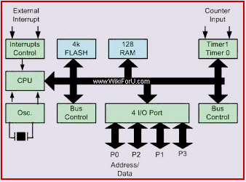
8051 Microcontroller Architecture

Slide 6
Central Processor Unit (CPU)
As we know that the CPU is the brain of any processing device of the microcontroller.
It monitors and controls all operations that are performed on the Microcontroller units.
The User has no control over the work of the CPU directly.
It reads program written in ROM memory and executes them and do the expected task of that application.

Slide 7
Interrupts
Interrupt is a subroutine call that interrupts of the microcontrollers main operations or work and causes it to execute any other program, which is more important at the time of operation.
An Interrupts gives us a mechanism to put on hold the ongoing operations, execute a subroutine and then again resumes to another type of operations.

Slide 8
Interrupts
8051 can be configured in such a way that it temporarily terminates or pause the main program at the occurrence of interrupts. When a subroutine is completed, Then the execution of main program starts. Generally five interrupt sources are there in 8051 Microcontroller is shown below:
INT0
TF0
INT1
TF1
R1/T1

Slide 9
Memory
The memory which is used to store the program of the microcontroller is known as code memory or Program memory of applications. It is known as ROM memory of microcontroller.
It also requires a memory to store data or operands temporarily of the microcontroller.
The data memory of the 8051 is used to store data temporarily for operation is known RAM Memory. 8051 microcontroller has 4K of code memory or program memory, that has 4KB ROM and also 128 bytes of data memory of RAM.

Slide 10
BUS
Here two types of buses that are shown in below
Address Bus: Microcontroller 8051 has a 16 bit address bus for transferring the data. It is used to address memory locations and to transfer the address from CPU to Memory of the microcontroller.
Data Bus: Microcontroller 8051 has 8 bits of the data bus, which is used to carry data of particular applications.

Slide 11
Oscillator
The microcontroller is a device, therefore it requires clock pulses for its operation of microcontroller applications.
For this purpose, microcontroller 8051 has an on-chip oscillator which works as a clock source for Central Processing Unit of the microcontroller.
The output pulses of oscillator are stable. Therefore, it enables synchronized work of all parts of the 8051 Microcontroller.

Slide 12
Input/Output Port and Timer
For this purpose 8051 has 4 input, output ports to connect it to the other peripherals
8051 microcontroller has two 16 bit timers and counters. These counters are again divided into a 8 bit register. The timers are used for measurement of intervals to determine the pulse width of pulses.

Slide 13
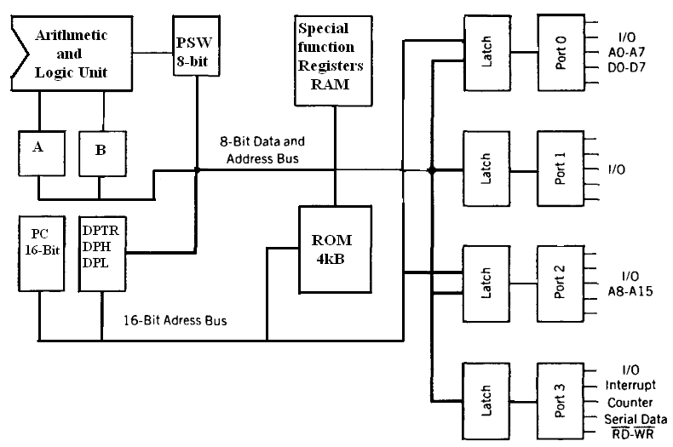
BLOCK DIAGRAM OF 8051 MICROCONTROLLER

Slide 14
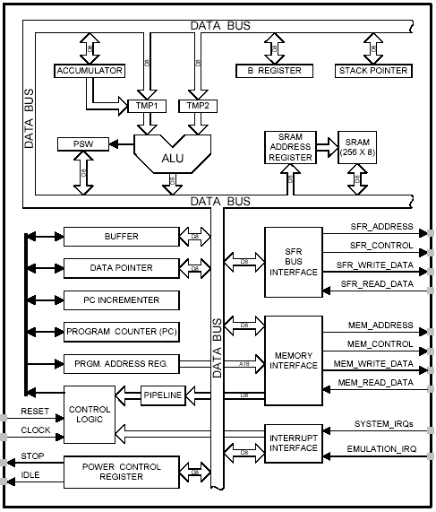
8051 CPU Registers
A (8-bit Accumulator)
B (8-bit register for Mul & Div)
PSW (8-bit Program Status Word)
SP (8-bit Stack Pointer)
PC (16-bit Program Counter)
DPTR (16-bit Data Pointer)

Slide 15
A and B Registers
The A register is also called the Accumulator and as its name suggests, is used as a general register to accumulate the results of a large number of instructions.
By default it is used for all mathematical operations and also data transfer operations between CPU and any external memory.
The B register is mainly used for multiplication and division operations along with A register.
MUL AB DIV AB
It has no other function other than as a location where data may be stored.

Slide 16
R registers
The "R" registers are a set of eight registers that are named R0, R1, etc. up to and including R7.
These registers are used as auxiliary registers in many operations. The "R" registers are also used to temporarily store values.

Slide 17
Program Counter(PC)
8051 has a 16-bit program counter. The program counter always points to the address of the next instruction to be executed.
After execution of one instruction the program counter is incremented to point to the address of the next instruction to be executed.
It is the contents of the PC that are placed on the address bus to find and fetch the desired instruction.
Since the PC is 16-bit width ,8051 can access program addresses from 0000H to FFFFH ,a total of 64kB of code.

Slide 18
Stack Pointer Register (SP)
It is an 8-bit register which stores the address of the stack top. i.e the Stack Pointer is used to indicate where the next value to be removed from the stack should be taken from.
When a value is pushed onto the stack, the 8051 first increments the value of SP and then stores the value at the resulting memory location.
Similarly when a value is popped off the stack, the 8051 returns the value from the memory location indicated by SP, and then decrements the value of SP.

Slide 19
Stack Pointer Register (SP)
The stack pointer in the 8051 is only 8 bits wide, which means that it can take values of 00 to FFH.
When the 8051 is powered up, the SP register contains value 07. This means that RAM location 08 is the first location used for the stack by the 8051.
The storing of a CPU register in the stack is called a PUSH, and pulling the contents off the stack back into a CPU register is called a POP.
SP is modified directly by the 8051 by six instructions: PUSH, POP, ACALL, LCALL, RET, and RETI.

Slide 20
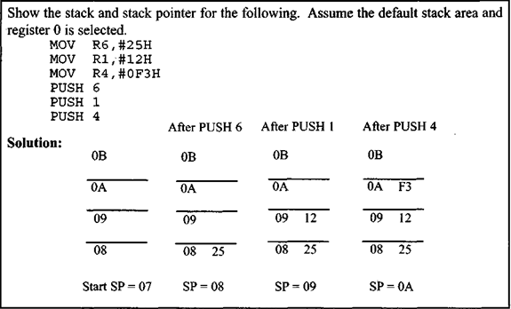
Pushing onto the stack
In the 8051 the stack pointer (SP) points to the last used location of the stack. As we push data onto the stack, the stack pointer (SP) is incremented by one.

Slide 21
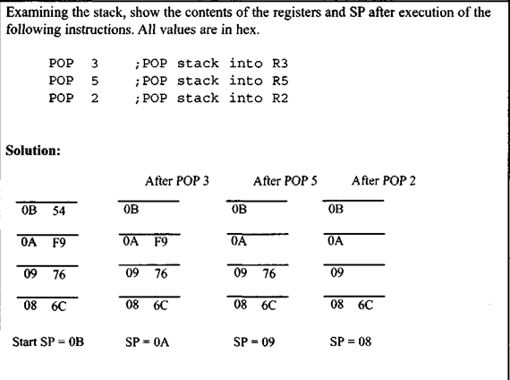
Popping from the stack
Popping the contents of the stack back into a given register is the opposite process of pushing. With every pop, the top byte of the stack is copied to the register specified by the instruction and the stack pointer is decremented once.

Slide 22
Data Pointer Register(DPTR)
It is a 16-bit register which is only user-accessible. DPTR, as the name suggests, is used to point to data.
It is used by a number of commands which allow the 8051 to access external memory.
When the 8051 accesses external memory it will access external memory at the address indicated by DPTR. This DPTR can also be used as two 8-registers DPH and DPL.

Slide 23
Register banks
A total of 32 bytes from locations 00 to IF hex are set aside for register banks and the stack.
These 32 bytes are divided into 4 banks of registers in which each bank has 8 registers, R0 – R7.
RAM locations from 0 to 7 are set aside for bank 0 of R0 – R7 where R0 is RAM location 0, R1 is RAM location 1, R2 is location 2, and so on, until memory location 7, which belongs to R7 of bank 0.
The second bank of registers R0 – R7 starts at RAM location 08 and goes to location 0FH and so on.

Slide 24
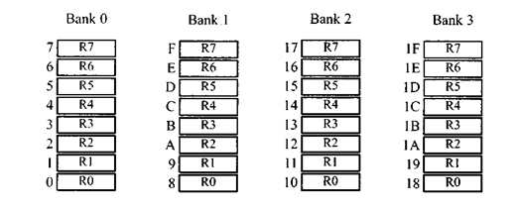
Register banks

Slide 25
Program Status Register (PSW)
The 8051 has a 8-bit PSW register which is also known as Flag register.
In the 8-bit register only 6-bits are used by 8051.The two unused bits are user definable bits. In the 6-bits four of them are conditional flags .
They are Carry –CY, Auxiliary Carry-AC, Parity-P and Overflow-OV .These flag bits indicate some conditions that resulted after an instruction was executed.
F0 is available to the user for general purpose.

Slide 26
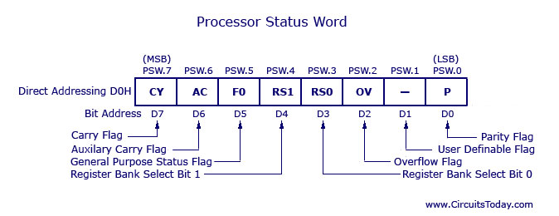
Program Status Register (PSW)
The bits PSW3 and PSW4 are denoted as RS0 and RS1 and these bits are used to select the bank registers of the RAM location.
The selection of the register Banks and their addresses are given on the next slide.

Slide 27
Program Status Register (PSW)
RS1 | RS0 | Register Bank | Address
0 | 0 | 0 | 00H-07H
0 | 1 | 1 | 08H-0FH
1 | 0 | 2 | 10H-17H
1 | 1 | 3 | 18H-1FH

Slide 28
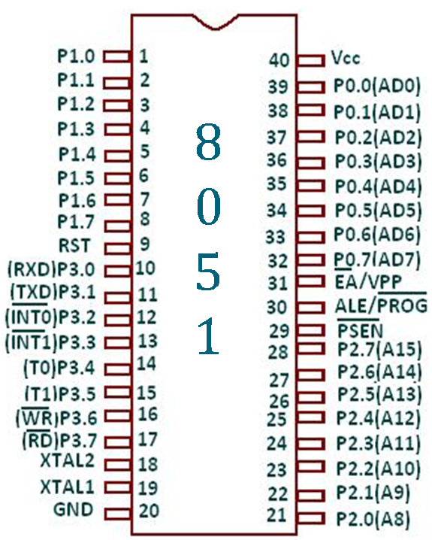
8051
Pin diagram:-

Slide 29
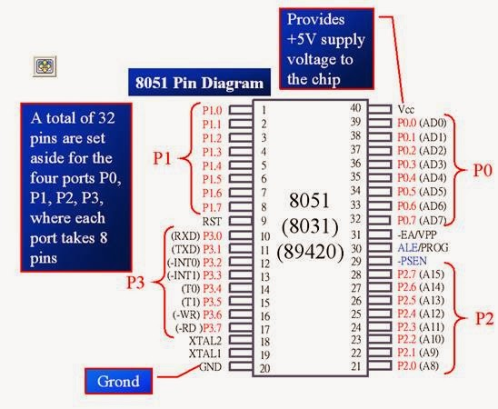

Slide 30
Pins of 8051
Vcc（pin 40）：
Vcc provides supply voltage to the chip.
The voltage source is +5V.
GND（pin 20）：ground
XTAL1 and XTAL2（pins 19,18）：
These 2 pins provide external clock.

Slide 31
XTAL Connection to 8051
Using a quartz crystal oscillator
We can observe the frequency on the XTAL2 pin.
C2
XTAL2
30pF
C1
XTAL1
30pF
GND

Slide 32
XTAL Connection to 8051
The 8051 has an on-chip oscillator but requires an external clock to run it. Most often a quartz crystal oscillator is connected to inputs XTAL1 (pin 19) and XTAL2 (pin 18). The quartz crystal oscillator connected to XTAL1 and XTAL2 also needs two capacitors of 30 pF value. One side of each capacitor is connected to the ground as shown in Figure.
It must be noted that there are various speeds of the 8051 family. Speed refers to the maximum oscillator frequency connected to XTAL. For example, a 12-MHz chip must be connected to a crystal with 12 MHz frequency or less. Likewise, a 20-MHz microcontroller requires a crystal frequency of no more than 20 MHz. When the 8051 is connected to a crystal oscillator and is powered up, we can observe the frequency on the XTAL2 pin using the oscilloscope.

Slide 33
Pins of 8051（2/4）
RST（pin 9）：reset
It is an input pin and is active high（normally low）.
Upon applying a high pulse to RST, the microcontroller will reset and all values in registers will be lost.

Slide 34
Pins of 8051（3/4）
/EA（pin 31）：external access
The /EA pin is connected to GND to indicate the code is stored externally.
If we have to use multiple memories then the application of logic 1 to this pin instructs the Microcontroller to read data from both memories: first internal and then external.
/PSEN（pin 29）：program store enable
This is an output pin and is connected to the OE pin of the ROM
This pin is used to enable external program memory. If we use an external ROM for storing the program, then logic 0 appears on it, which indicates Micro controller to read data from the memory.

Slide 35
Pins of 8051（4/4）
ALE（pin 30）：address latch enable
It is an output pin and is active high.
8051 port 0 provides both address and data.
The ALE pin is used for de-multiplexing the address and data by connecting to the G pin of the 74LS373 latch.
I/O port pins
The four ports P0, P1, P2, and P3.
Each port uses 8 pins.
All I/O pins are bi-directional.

Slide 36
Pins of I/O Port
The 8051 has four I/O ports
Port 0 （pins 32-39）：P0（P0.0～P0.7）
Port 1（pins 1-8） ：P1（P1.0～P1.7）
Port 2（pins 21-28）：P2（P2.0～P2.7）
Port 3（pins 10-17）：P3（P3.0～P3.7）
Each port has 8 pins.
Named P0.X （X=0,1,...,7）, P1.X, P2.X, P3.X
Ex：P0.0 is the bit 0（LSB）of P0
Ex：P0.7 is the bit 7（MSB）of P0
These 8 bits form a byte.
Each port can be used as input or output (bi-direction).
Notes:
Program is to read data from P0 and then send data to P1

Slide 37
Links (Pin Diagram explanation)
http://www.zseries.in/embedded%20lab/8051%20microcontroller/pin%20diagram%20of%208051.php#.WDGmqLn0dL4
http://what-when-how.com/8051-microcontroller/pin-description-of-the-8051/
https://www.elprocus.com/pin-diagram-of-8051-microcontroller/
https://www.youtube.com/watch?v=6GXipPBLxB0&t=398s

Slide 38
Thank You

